Slide 1

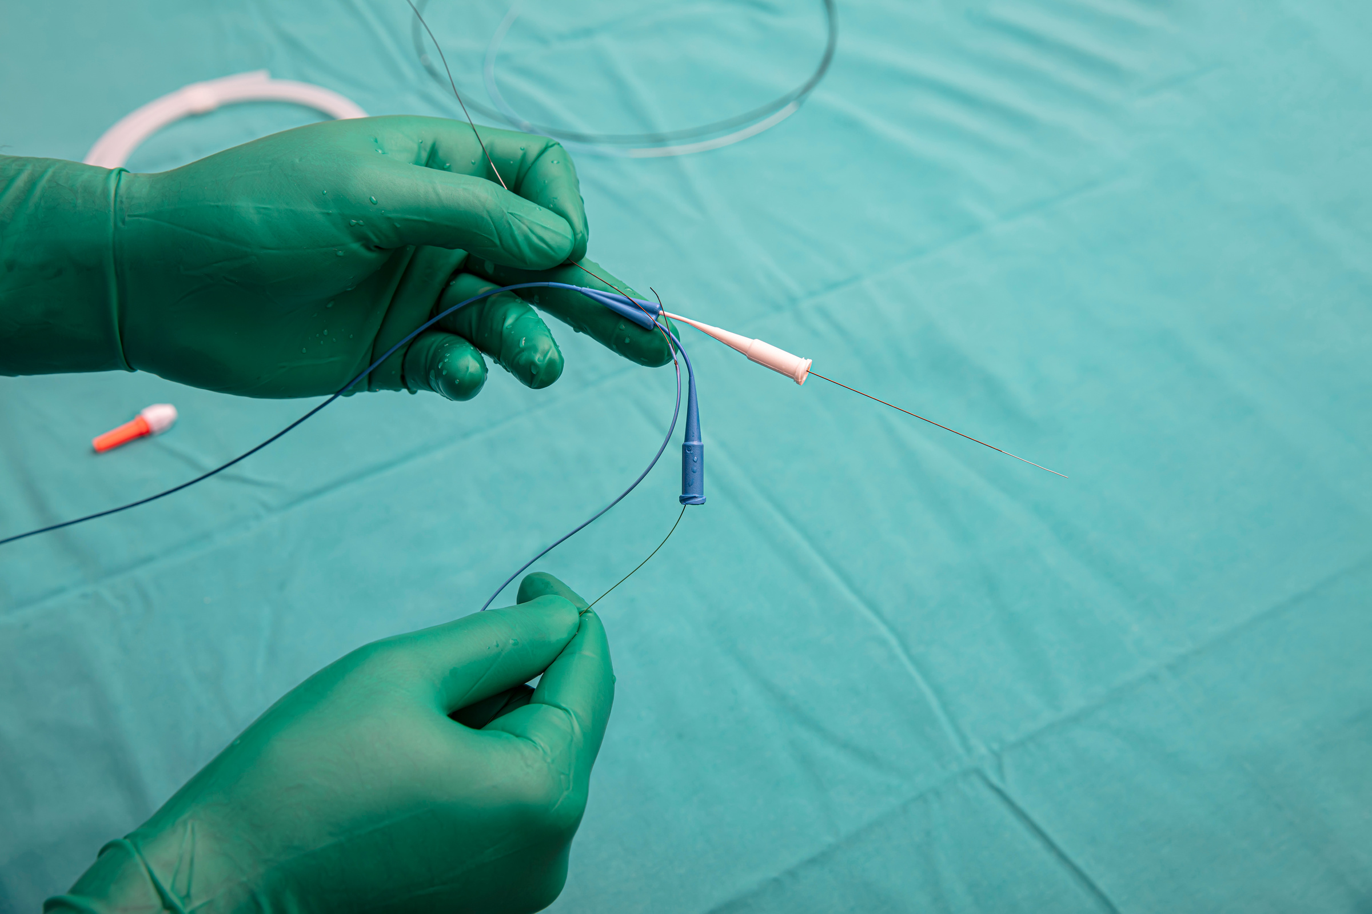
ENT6606 - NEW PRODUCT DEVELOPMENT
WIRE CO.
FINAL PROJECT: PORTFOLIO ANALYSIS

Slide 2
TABLE OF CONTENT
1.
Risk/NPV Chart and Risk/ROI Chart Analysis
2.
Resource Building/Competitive Advantage and Resource Building/NPV Chart Analysis
3.
New Product Portfolio Analysis
4.
Recommendations

Slide 3

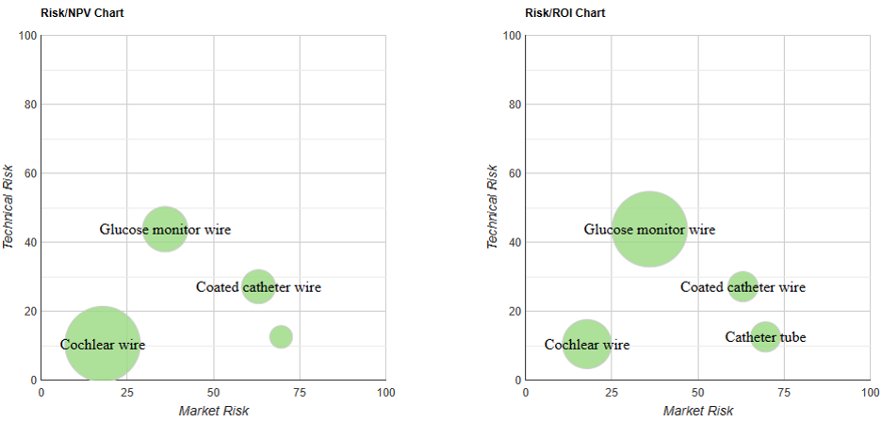
RISK/NPV CHART AND RISK/ROI CHART ANALYSIS

Slide 4
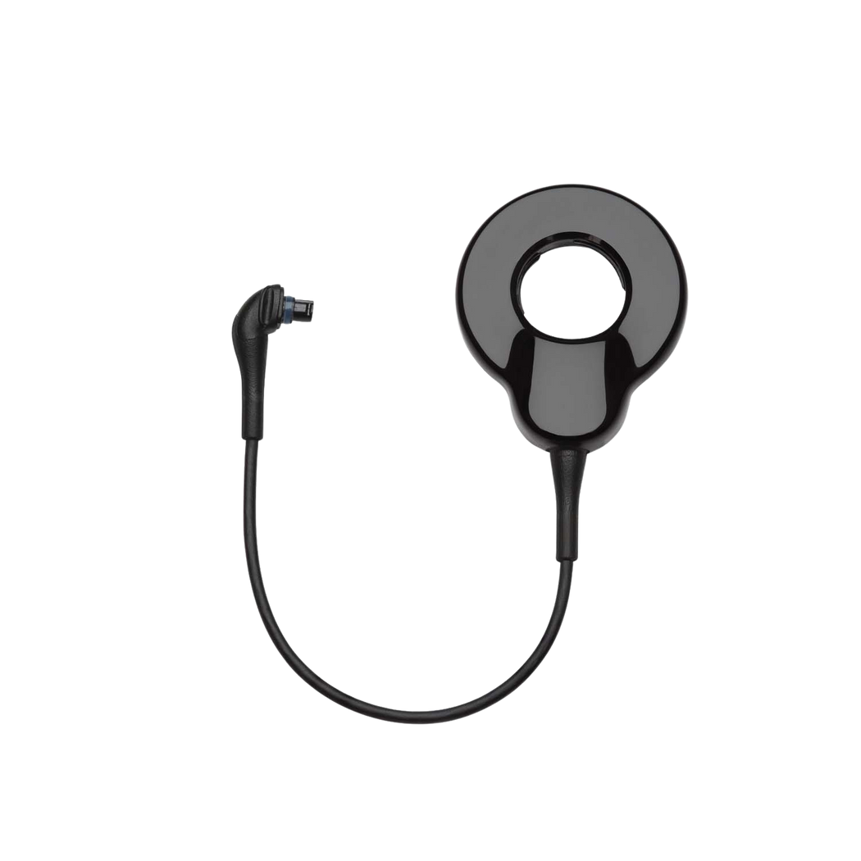





RISK/NPV CHART AND RISK/ROI CHART ANALYSIS
COCHLEAR WIRE
Used to enhance hearing of hearing impaired individuals
Position
Lower left quadrant
Low technical and market risk
Technical Risk (10%)
High confidence in technical feasibility
High chance of successful technical implementation
Market Risk (18%)
Favorable or well-understood market
Maybe WireCo serves same/similar market
NPV ($4,094,165)
Highest NPV of four projects
Suggests strong financial potential / Most financially lucrative project
ROI (2,047%)
Second highest ROI

Slide 5
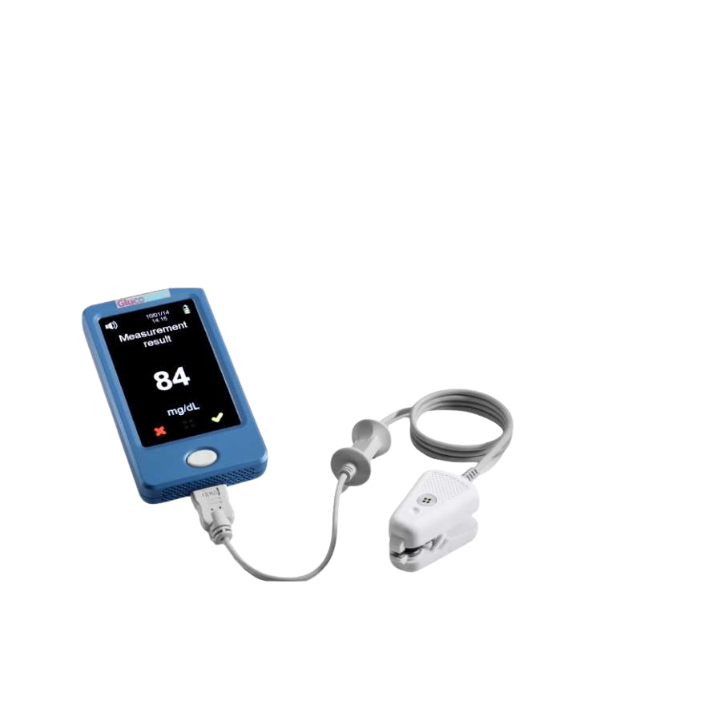
RISK/NPV CHART AND RISK/ROI CHART ANALYSIS
GLUCOSE MONITOR WIRE
Used to monitor glucose levels (sugar in the blood)
Mostly by people with health problems such as diabetes
Position
Middle left quadrant
Moderate to high technical risk & low market risk
Technical Risk (44%)
Highest technical risk among projects
Indicates need for a more robust and comprehensive technical development plan
Market Risk (36%)
Moderate market risk
NPV ($1,416,257)
Second highest NPV among projects
ROI (4,720%)
Highest ROI among projects
If risks are managed properly, the potential returns can be highly lucrative

Slide 6
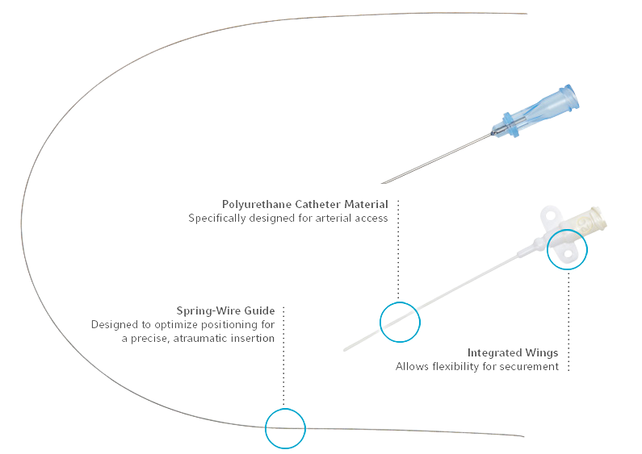
RISK/NPV CHART AND RISK/ROI CHART ANALYSIS
COATED CATHETER WIRE
Inner part of a catheter system
Usually found in IV units for Central Venus Catether insertions
Position
Upper right quadrant
High market risk and moderate technical risk
Technical Risk (27%)
Uncertaintiesin technical aspects
Not as high risk as the Glucose monitor wire
Market Risk (63)
Volatile market or significant competition
Adoption issues
NPV ($840,062)
Lower than previous products
Less financially attractive
ROI (763%)
Relatively low when compared to those of the Cochlear wire and Glucose monitor wire
Need for strong marketing strategy

Slide 7
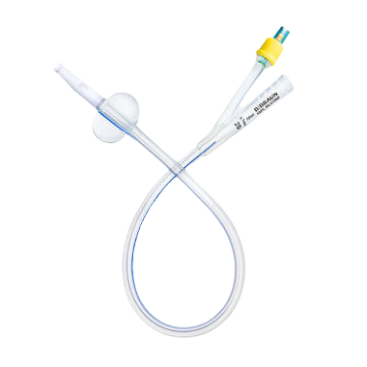
RISK/NPV CHART AND RISK/ROI CHART ANALYSIS
CATHETER TUBE
Can be used in most IV tubing systems
Standalone use consists mostly of Urinary catheter systems
Position
Lower right quadrant
Low technical risk but high market risk
Technical Risk (13%)
Project’s technology is well-understood and manageable
High likelihood of successful technical implementation
Market Risk (70%)
Highest amongst four projects
High due to entering a new market, high competition, potential regulation changes, or uncertainty in market acceptance
NPV ($362,696)
Smallest NPV among projects
Lowest financial potential, making it the least financially attractive project
ROI (725%)
Lowest ROI among all projects

Slide 8
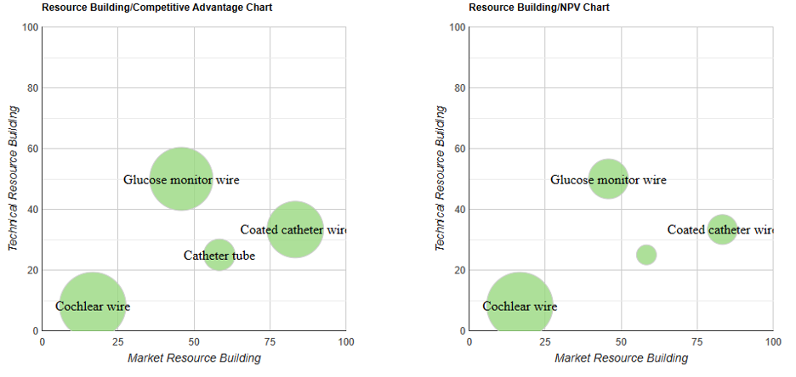
RESOURCE BUILDING/COMPETITIVE ADVANTAGE AND RESOURCE BUILDING/NPV CHART ANALYSIS

Slide 9


RESOURCE BUILDING/COMPETITIVE ADVANTAGE AND RESOURCE BUILDING/NPV CHART ANALYSIS
COCHLEAR WIRE
Position
Lower left quadrant
Suggests minimal technical and marketing investment will be needed
Technical Resource Building (8%)
Very Low
Suggests that not a lot of resource allocation is required for its development
Market Resource Building (17%)
Low
Implies efficient market penetration strategies or a well-established market presence
Competitive Advantage (80%)
Significantly high
Implies efficient market penetration strategies or well-known market
NPV and Risk-adjusted Resource Building (10.32%)
Highest NPV of four projects
Suggests that project is highly profitable even with low resource input
Risk-adjusted resource building estimate: 12 x (1- 0.14) = 10.3

Slide 10
RESOURCE BUILDING/COMPETITIVE ADVANTAGE AND RESOURCE BUILDING/NPV CHART ANALYSIS
GLUCOSE MONITOR WIRE
Position
Middle of graph
Indicates substantial technical and market resource building
Technical Resource Building (50%)
Highest of four projects
Suggests need for significant investment in R&D or technical expertise acquisition
Market Resource Building (46%)
Moderate relative to other projects
May include marketing, sales channels, or customer education efforts
Competitive Advantage (73%)
Large bubble sizes signifies a strong competitive position
Likely due to innovative nature of the product and differentiation from competitors
NPV and Risk-adjusted Resource Building (40%)
Second highest NPV
Indicates a strong potential for financial success
Risk-adjusted resource building estimate: 47.2 x (1- 0.4) = 28.32

Slide 11
RESOURCE BUILDING/COMPETITIVE ADVANTAGE AND RESOURCE BUILDING/NPV CHART ANALYSIS
COATED CATHETER WIRE
Position
Upper right quadrant
Points to a major focus on market resources over technical resources
Technical Resource Building (33%)
Moderate
Relatively higher than Cochlear wire but lower than the Glucose monitor wire.
This project consumes a moderate share of technical resources, suggesting a balanced approach to technical development.
Market Resource Building (83%)
Very high
Reflects a strategy that possibly focuses on market penetration, customer acquisition, and branding
Competitive Advantage (57%)
The competitive advantage suggests that, while the project has a competitive edge, it may not be as strong as Glucose monitor wire.
NPV and Risk-adjusted Resource Building (33%)
The NPV of $840,062 implies a moderate level of profitability in relation to the resources committed
The mean resource building is 60 while the mean risk is 45%
Risk-adjusted resource building estimate: 60 x (1-0.45) = 33

Slide 12
RESOURCE BUILDING/COMPETITIVE ADVANTAGE AND RESOURCE BUILDING/NPV CHART ANALYSIS
CATHETER TUBE
Position
Right middle, indicating a higher emphasis on market resource building compared to technical resource building.
Technical Resource Building
Low at 25%, suggesting that the project may not be as technically demanding. This project consumes a moderate share of technical resources, suggesting a balanced approach to technical development.
Market Resource Building (58%)
High
Perhaps due to having to overcome the high market risk identified in the previous charts
This project requires a significant amount of market resources, emphasizing the importance of a well-designed marketing and commercialization plan.
Competitive Advantage (19%)
The smallest bubble size among the four projects, suggesting that even with the investment in market resources, the competitive advantage gained is the least
This might be due to stiff competition or a less differentiated product
Risk-adjusted Resource Building (23.4%)
The NPV of $362,696 is the smallest of the four projects
Reflects the lowest financial potential among the projects
The mean resource building is 40 while the mean risk is 41.5%
Risk-adjusted resource building estimate: 40 x (1- .415) = 23.4

Slide 13
NEW PRODUCT PORTFOLIO ANALYSIS
PORTFOLIO VALUE
PORTFOLIO BALANCE
POTENTIAL FOR RENEWAL
Analysed through project’s NPV and ROI
Cochlear Wire shines as the most lucrative venture with impressive $4.1M NPV and 2047% ROI
Glucose Monitor Wire offers $1.4M NPV and outstanding 4720% ROI despite high risks
Coated Catheter Wire and Catheter Tube have lower financial attractiveness, positioning themselves as conservative investments
Evident through varying resource utilization and competitive advantage
Cochlear Wire offers minimum resource utilization and maximum competitive edge
Glucose Monitor Wire consumes substantial resources (50% tech, 46% market) with 73% advantage
Crucial for maintaining a healthy diversified portfolio capable of sustaining long-term growth and flexible to market dynamics
Indicated by inherent strength of top projects
Cochlear Wire: stable foundation with low risk, high financial returns, efficient resources utlization
Glucose Monitor Wire: high-growth potential (high ROI), significant competitive advantage despite high risks
Catheter Tube: Potentially lead to renewal if manages to overcome its market risks
Notes:
Niraj

Slide 14

RECOMMENDATIONS
Main Project
Secondary Project
Prioritize Cochlear Wire project
Low risks, high-risk adjusted NPV and ROI
Can provide strong financial foundation to fund risky and future ventures
Keep Glucose Monitor Wire as secondary priority
Moderate risks but massive profitabilty enabler
Potential to be a market leader due to high competitive advantage

Slide 15
RECOMMENDATIONS
Expand Market Research
Explore New Industries
Intensify market research for Coated Catheter Wire and Catheter Tube to gather more data
Understand market dynamics to enhance projects strategic value
Explore diversification opportunities beyond traditional market
Spread risk and uncover new growth potentials
Remain cautious of overcommitting to marginal value projects that may dilute focus and erode long-term innovation capabilities

Slide 16
THANK YOU!

